Slide 1
What does the Inflation Reduction Act mean for your electrification plans?
Matt Christie
Strafford Energy & Climate Committee member

Slide 2
Agenda
The BIG Picture – The IRA is a huge deal for climate
Consumer facing provisions:
Low-income provisions (up to 150% of AMI)
HEEHRA - point-of-sale rebates for electrification and efficiency measures
HOMES - measured whole-home energy savings
Higher-income tax-credits
25C - heat pumps, home improvements
25D - solar, home batteries, ground-source heat pumps
45L - highly efficient new construction
Electric Vehicle tax credits

Slide 3
The IRA is a BIG Deal

Slide 4
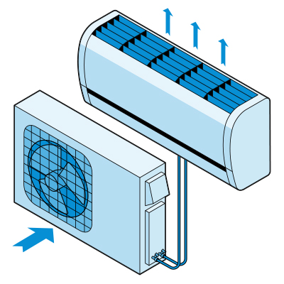
Over $350 Billion in Climate Action

Slide 5
Over $350 Billion in Climate Action
Manufacturing support
Consumer rebates and tax credits
Methane leakage fee
Domestic supply chain development support
Environmental justice provisions
Clean transportation investment
Postal fleet electrification
Establishes a green bank
Support grid electrification
Clean fuels
Agriculture and forest land conservation
Land conservation and resilience
Environment and public works
Tribal electrification program
Heavy duty vehicles program

Slide 6
Modeled Savings Impact
*information taken from Zero Lab of Princeton’s Repeat project - https://repeatproject.org/docs/REPEAT_IRA_Prelminary_Report_2022-08-04.pdf

Slide 7
Modeled Savings Impact

Slide 8
Consumer Provisions
Low-income programs

Slide 9
We don’t know yet!
IRA appropriated funds with specific limits and targeted sectors
BUT - Both low-income programs are still in rulemaking and planning stages – we won’t know until late 2023, early 2024

Slide 10
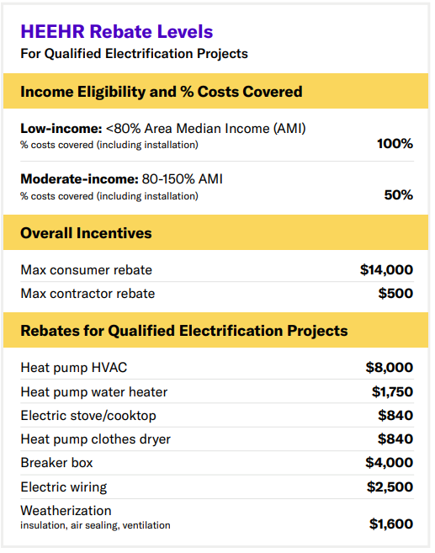
High Efficiency Electric Home Rebate Act (HEEHRA)
$4.275B (not really that much) –likely will run out quickly
Point-of-sale rebate system
Likely stackable with Efficiency VT and GMP incentives/rebates (at state discretion)
Likely to be implemented by Efficiency VT
AMI ~ $80-$95K across the Upper Valley. Woodstock is $90,100
https://ami-lookup-tool.fanniemae.com/amilookuptool/
*Table taken from Rewiring America - https://www.rewiringamerica.org/ira-fact-sheets
Notes:
The electrical energy used to pump this heat, can come from either your electric utility or from solar panels.

Slide 11
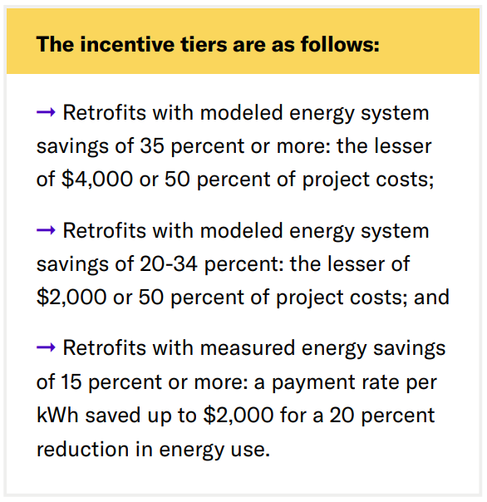
Home Owner Managing Energy Savings Rebates (HOMES)
$4.5B (not really that much) –likely will run out quickly
Available for all households, but incentives are doubled for low-income (<80% AMI)
Cannot stack with HEEHRA or tax credits
Allows for an energy efficiency aggregator approach
A company would pay for the improvement, and reap a share of the reward
*Table taken from Rewiring America - https://www.rewiringamerica.org/ira-fact-sheets
Notes:
The electrical energy used to pump this heat, can come from either your electric utility or from solar panels.

Slide 12
Consumer Provisions
Tax Credits

Slide 13
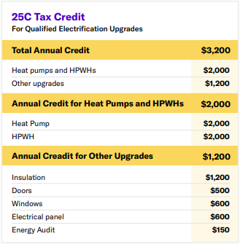
Energy Efficiency Home Improvement Tax Credit (25C)
No limit! Can’t run out
Available NOW!
Non-refundable tax-credit (must have federal tax liability to claim)
30% of incurred cost or $X,XXX (most cases it will be the dollar limit)
Annual credit limits reset each year
*Table taken from Rewiring America - https://www.rewiringamerica.org/ira-fact-sheets

Slide 14
25C – Air Source Heat Pump Efficiency Requirements
Must meet the Consortium for Energy Efficiency’s (CEE) most efficient tier for the North/Canada region:
Appropriate standard for cold-climates. Doesn’t limit equipment options.

Slide 15
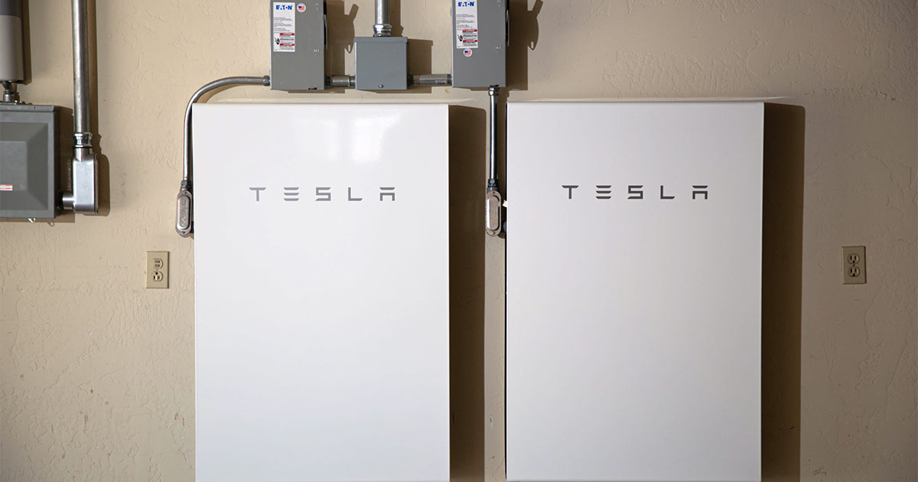
Clean Energy Tax Credit (25D)
Solar
No limit! Can’t run out
Available NOW!
Non-refundable tax-credit (must have federal tax liability to claim)
30% of incurred cost – uncapped!
Carry-forward applies, so households may roll over unused credits year over year
Home Batteries
Ground Source Heat Pumps (GSHP)

Slide 16
New Energy Efficient Home Tax Credit (45L)
New homes and gut-retrofits
$2,500 for ENERGY STAR certification
$5,000 for DOE’s Zero Energy Ready Homes Program certification
Designed for production builders. For custom projects, the costs of certification may substantially eat into the credit.

Slide 17
Consumer Provisions
Electric Vehicle Tax Credits

Slide 18
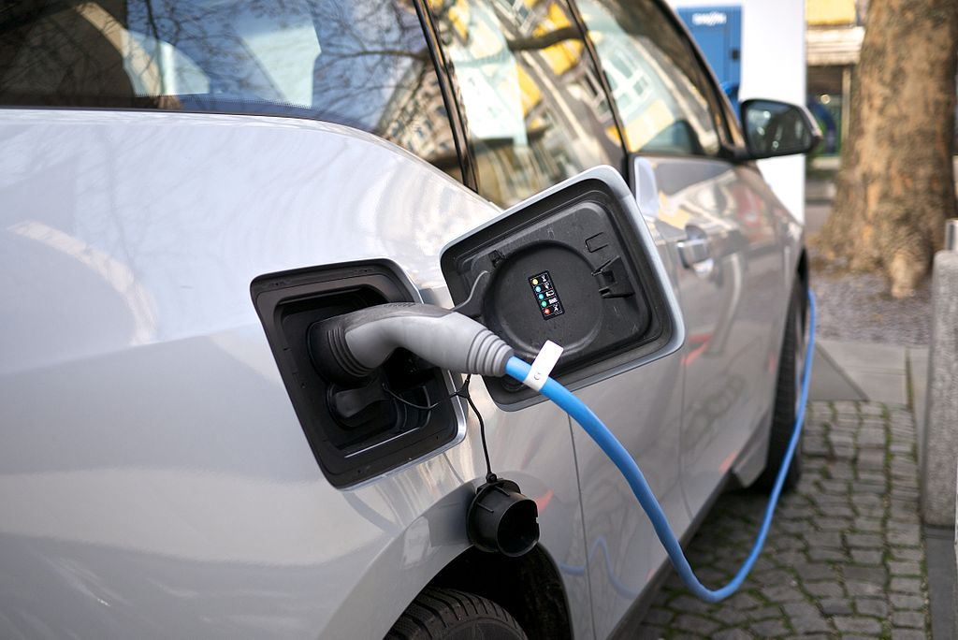
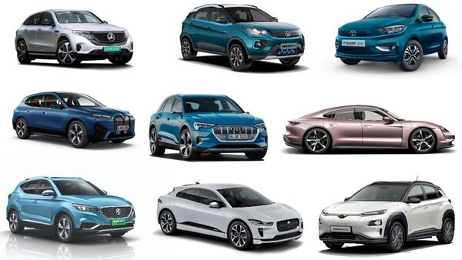
Clean Vehicle Tax Credit (30D) – New Cars
Available now!
Up to $7,500 for new vehicle
Not available on luxury models
>$55K for cars
>$80K SUVs, vans, pickups
Income limits
$150K for single-filers,
$225K for head of household
$300K for joint filers
Lifted manufacturer-caps
Will be point-of-sale in 2024 (transfer of credit to the dealer)
Requirements regarding domestic materials sourcing/processing and manufacturing

Slide 19
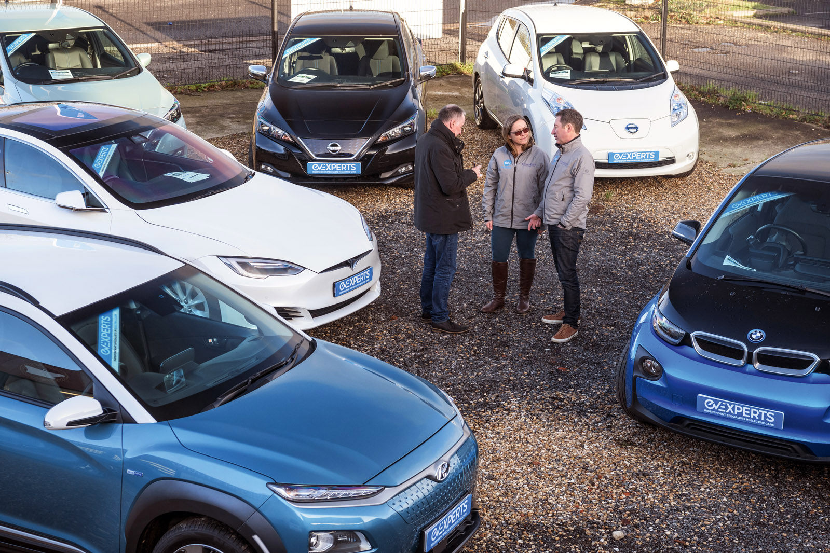
Clean Vehicle Tax Credit (30D) – Used Cars
Available now!
Up to $4,000 for a used vehicle, or 30% (whichever is less)
Must be at least 2 years old
Must be under $25K
Sold by a dealer
Income limits
$150K for single-filers,
$225K for head of household
$300K for joint filers
Can only be applied once per vehicle

Slide 20
Questions?

